Slide 1
Predicting Depression Rates
Ryan Nebblett, Ali Manekia, Chris Cornelius, Ben Pientrancosta, Yessika Zurita
March 15, 2023

Slide 2
Agenda
Problem Statement
Data Overview
Machine Learning Modeling
Dashboard

Slide 3
Problem Statement
What features best predict depression rates at a county level?
Impact: Targeted policies and providing a layman’s understanding of what may indicate depression.

Slide 4
Data overview: Raw data
Data sets:
Health -> Medical conditions
Transportation -> Resident travel behavior
IRS -> Income data
Employment -> Job titles and average income
Data sources and relationships -> Federal government data joined by FIPS code.

Slide 5
Data overview: Data storage
Database tables -> Each data set corresponds to a unique table in Postgres
Reference and join tables -> Used intermediary tables to better define certain data via PK/FK relationships, e.g. is the definition of job title.

Slide 6
Machine Learning Modeling Process Overview
Data Preprocessing
Manual feature selection from 2,400 independent variables to 30
Z-score scaling (all numeric)
Reduce multicollinearity through VIF calculation and feature reduction
Linear ML Models for Continuous Variable: OLS, Ridge, LASSO
Non-Linear ML Models for Continuous Variable:
Random Forest Regression on scaled subset of features
Random Forest Regression on entire set of unscaled features

Slide 7
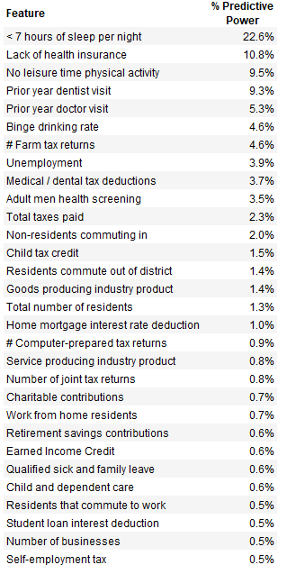
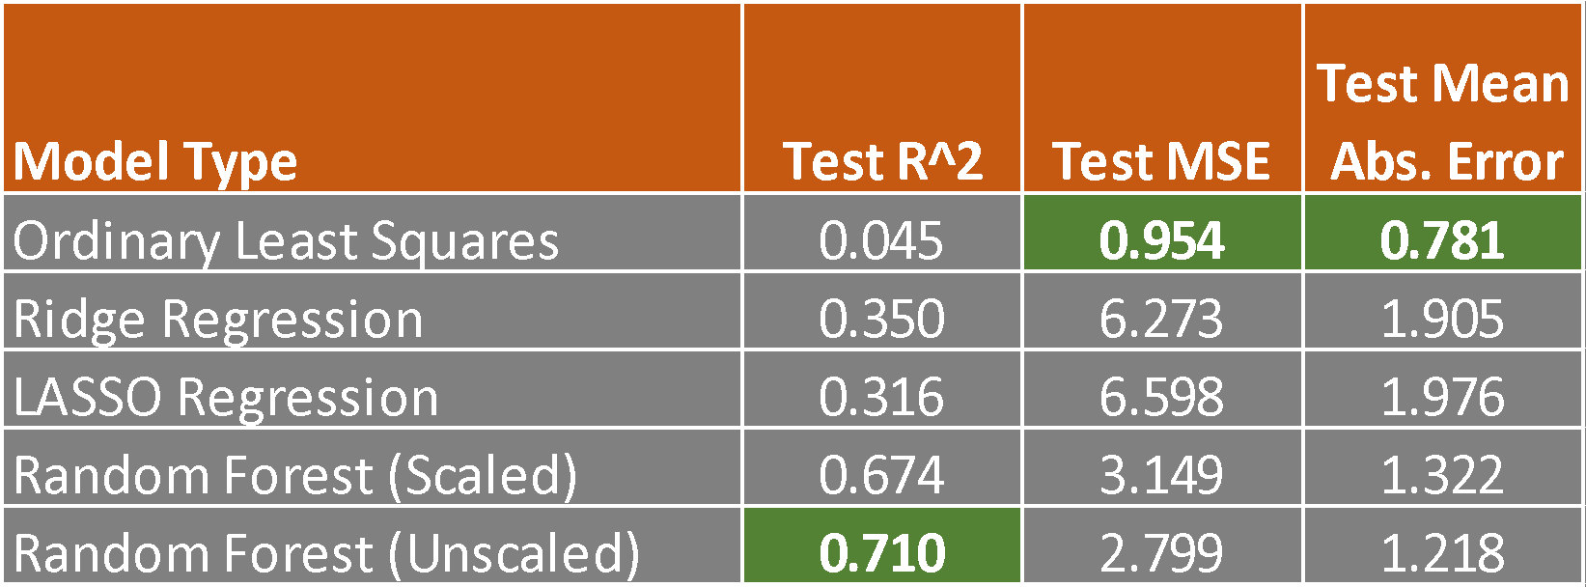
Machine Learning Modeling Results Comparison

Slide 8
Visualization
Tableau visualization -> Why this technology?
Visualization form -> Geographic heatmap of the US at a county level:
Meaning of color -> Fluctuates based on depression rate
Feature details -> When hovering all features and their values will show in the display box with the corresponding US average

